Slide 1
LIS 4404 – Week 1 Agenda
Introductions
Structure of the Class
Introduction to metadata
Introduction to the different types of metadata
The one-to-one principle
Systems and standards
Break
Lab
Notes:
agenda for the lecture, March 24, 2015

Slide 2
What is metadata?
Definitions
Examples
Notes:
Some definitions of metadata:
data about data
the information you know in order to find out the information you don’t know
“structured data about an object that supports functions associated with the designated object” (Greenberg, 2003)

Slide 3
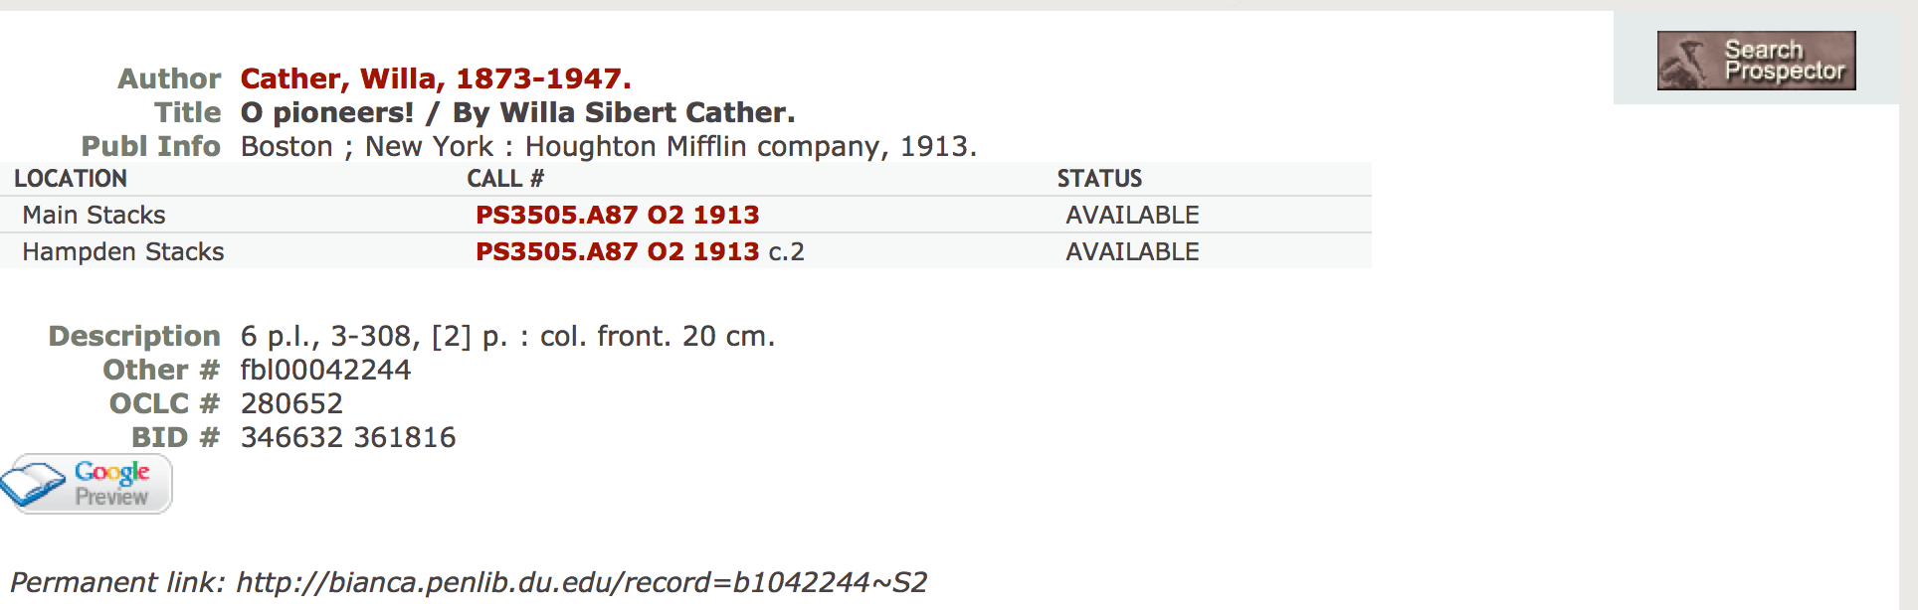
DU Library Catalog: http://bianca.penlib.du.edu/record=b1042244~S2
Notes:
The first of a few examples of metadata in practice. Here is a snippet of the public catalog view for O Pioneers! by Willa Cather. Note the two separate areas of the record; the top half, with basic information such as author, title, and location of the item, is targeted at users, while the bottom half (mostly identifiers) is targeted at expert users and catalogers. These separate functions are an example of the different usage types metadata is meant to support in a library catalog.

Slide 4
LEADER 00000nam a22000001 4500 001 280652
003 OCoLC
005 19830806135255.0
008 800321s1913 mau 000 1 engm
010 13015167 //r802
019 346632|a361816
035 fbl00042244
040 DLC|cDLC|dm.c.|dDVP
049 DVPP|c1
090 PS3505.A87 O2 1913
100 1 Cather, Willa,|d1873-1947.
245 10 O pioneers! /|cBy Willa Sibert Cather.
260 Boston ;|aNew York :|bHoughton Mifflin company,|c1913.
300 6 p.l., 3-308, [2] p. :|bcol. front.|c20 cm.
919 MARCIVE|dSpring 2011
Same record; raw MARC display.
Notes:
Here we see the MARC display of the same record. There are many more metadata elements here—the Leader, the 0** fields, the 919 field—which are meant for, and mainly understood by, catalogers and catalog managers.

Slide 5
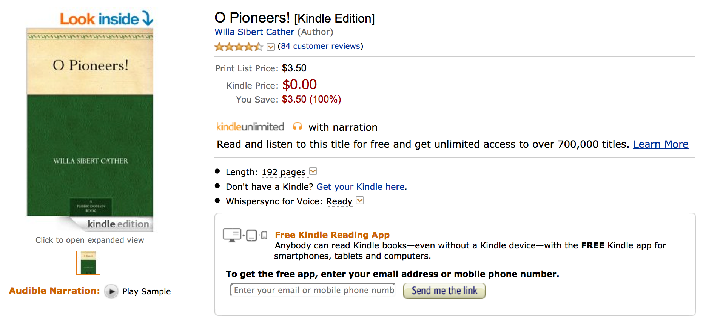
O Pioneers! on Amazon: http://www.amazon.com/O-Pioneers-Willa-Sibert-Cather-ebook/dp/B0083ZQRP6/ref=sr_1_2?ie=UTF8&qid=1427222334&sr=8-2&keywords=o+pioneers
Notes:
Here is the representation of O Pioneers! on Amazon. It functions much more like a marketplace, with the price information made prominent (as opposed to hidden, or not available at all, as it would be in a library catalog), and customer reviews made available. There are many more links and user functions available as well.

Slide 6
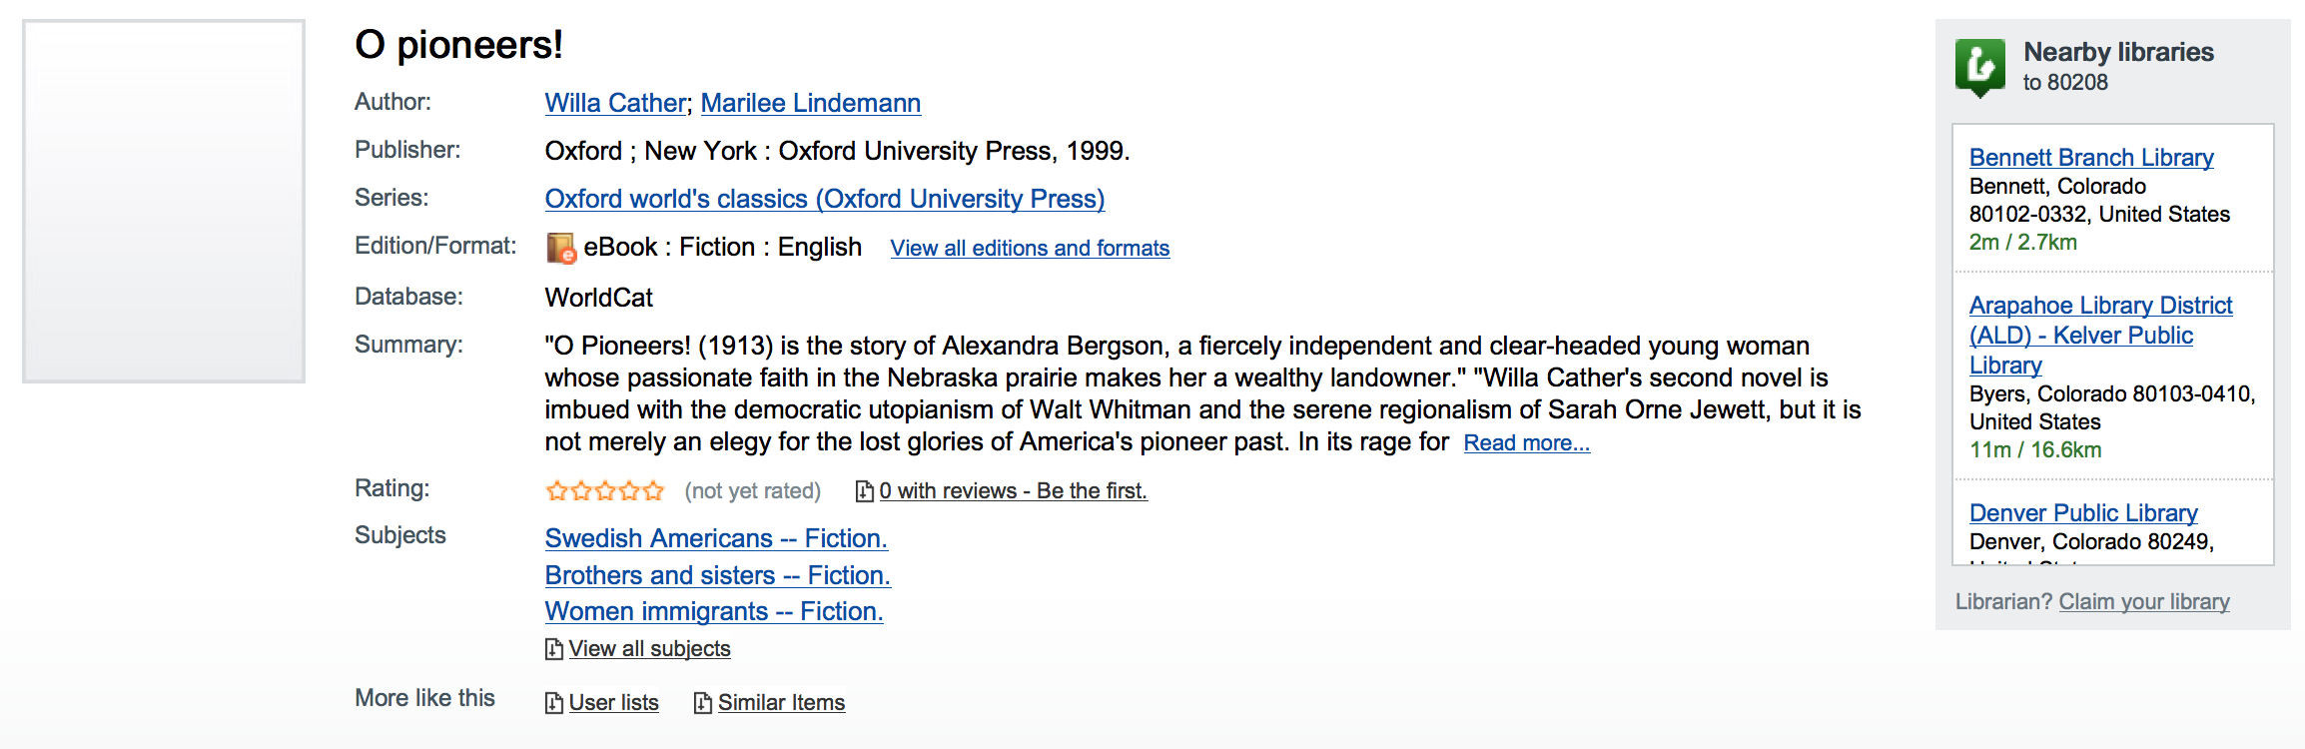
O Pioneers! on WorldCat: http://www.worldcat.org/title/o-pioneers/oclc/47010527
Notes:
O Pioneers! on OCLC WorldCat combines aspects of both the DU library catalog and the Amazon database, providing more links and more bibliographic description, while also (further down the page, not visible on the slide) providing information about nearby libraries holding the item. Some of the links—to “all editions and formats,” or the ability to view all subjects—are targeted to catalogers and more advanced users of the site.

Slide 7
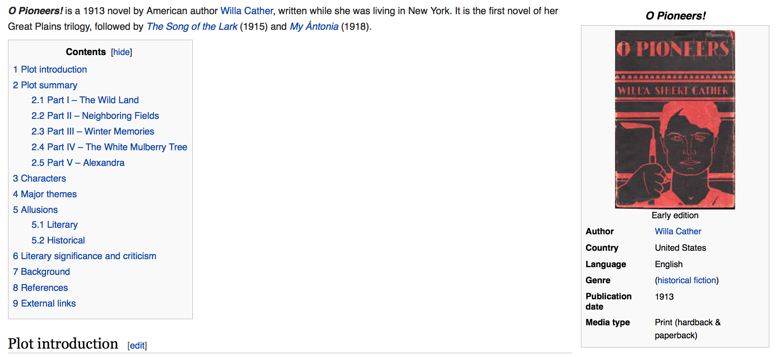
O Pioneers! on Wikipedia: http://en.wikipedia.org/wiki/O_Pioneers!
Notes:
The last example is O Pioneers! on Wikipedia. Note the info box on the right. DBPedia, a site which collects data from Wikipedia and publishes it as linked open data on the Web, collects this information and treats it as its basic metadata record for the book. This is an example of work-level metadata, as opposed to the previous examples (which focus more on expressions and manifestations). All are part of the FRBR content model, which will be explained in an upcoming slide.

Slide 8
Different types of metadata
Descriptive
Structural
Administrative
Notes:
There are three primary types of metadata, some of which we have seen examples of already:
Descriptive metadata, representing metadata about the object and its contents. For a book, its author, title, and publisher would be descriptive. A digital photograph’s descriptive metadata would include the photographer, the subjects of the photo, when it was taken, and so forth.
Structural metadata reflects metadata about the intellectual structure or layout of the object. An example would be a scrapbook, where there is metadata about the book itself, and metadata documenting the photographs and clippings within the book as well as their relationship to each other. METS (http://loc.gov/standards/mets) is primarily a structural metadata standard.
Administrative metadata is any metadata allowing for management or curation of an object, such as technical, rights, or usage metadata. Identifiers such as OCLC numbers, local classification numbers, etc. would also be administrative metadata. Some administrative metadata elements can also serve as descriptive metadata depending on the context.

Slide 9
The one-to-one principle
One “thing,” one metadata record
Notes:
The one-to-one principle is the idea that a metadata record should only represent one thing. For example, if you were to have (1) a print photograph, (2) contained in a box, (3) which was part of a larger collection of photographs, (4) and that print photograph had also been digitized, it would require four separate metadata records to document everything about the situation. This is a common mistake among e.g. digital repository systems, where the metadata presented to the user representing a digital object is often just the metadata for its original physical form, with little if any attempt made to represent the digital surrogate (e.g. extent information is represented in length and width instead of megabytes). We will return to this principle throughout the course.

Slide 10
The one-to-one principle
One “thing,” one metadata record
FRBR model
BIBFRAME
Dublin Core Abstract Model
Notes:
Some data models which make use of the one-to-one principle are as follows:
FRBR, which represents library metadata as works, expressions, manifestations, and items, is one way to reflect this principle. In the FRBR model, if we take “Hamlet” as an example,
-- “Hamlet” would be the Work
-- Expressions of “Hamlet” would include the Shakespeare stage play, the film version starring Laurence Olivier, the film version starring Kenneth Branagh, a radio play performed of it, etc.
-- A Manifestation of any of these Expressions would be a recorded version of it, e.g. a published print version of the script, or the Blu-Ray of the Branagh version.
-- An Item would be any copy of those Manifestations held by a library.
BIBFRAME, which is the planned replacement of MARC being developed at the Library of Congress, simplifies this somewhat by having Works and Manifestations as the core units of the data model. So there would be an authority record for the work (“Hamlet”), to which one would link the published script, the Blu-Ray version of the Branagh Hamlet, etc., as distinct Manifestations of the Work. BIBFRAME also includes Annotations, which (among other things) allow a library to represent their holdings of any of these manifestations.
The Dublin Core Abstract Model is based on the one-to-one principle, using the <dc:relation> element to bind together related items, such as a digital surrogate and its analog source. We will discuss the DC Abstract Model in more detail next week.

Slide 11
Systems and standards
Where metadata lives
How metadata can be encoded
Notes:
We’ve seen a few different systems already, and the ways in which different metadata about a single thing can be represented in different ways according to the purpose of a system. In a library and archival context, it’s important to see the ways in which metadata about the same collection or item are used differently according to different needs. For example, in Special Collections at DU we use Sierra (library ILS) and ArchivesSpace (archival collection management system) to manage box-level metadata for all of our collections, but the purposes are different. We use Sierra entirely for inventory control and circulation; ArchivesSpace is used to document preservation needs, digitization activity, and the relationship between a box and the collection to which it belongs (as well as other levels of description within a collection).
Metadata can be encoded in a number of formats depending on the system. Sierra, like any ILS, is primarily a MARC-based system, whereas ArchivesSpace is built with EAD in mind. Since we use much of the same metadata in both places, knowing how to map two standards to each other, and transform metadata from one to the other, is essential for metadata librarians. We will cover issues related to this slide in more detail during the quarter.

Slide 12
Week 1 Lab
Metadata assertions about an object
http://hdl.handle.net/10176/codu:66783
Notes:
Information about the Week 1 Lab is available on the Canvas site.

